Slide 1

National Income

Slide 2
Outline
Definition of National Income
Modern Concepts to determine national income
Ways of Calculating National Income
Uses of National Income Data

Slide 3
National Income
-total earnings of the factors of production owned by its citizens or the total market value of all final goods and services produced by its citizens.
- the total net value of all goods and services produced within a nation over a specified period of time, representing the sum wages, profits, rents, interest, and pension payments to residents of the nation.

Slide 4
Modern concepts to determine national income
Gross National Product (GNP)- is the total market value of all final goods and services produced by citizens in one year.
Gross Domestic Product (GDP)- is the total market value of all final goods and services produced within the territory of a country in one year.

Slide 5
Modern concepts to determine national income
Per Capita Income (PCI)- is income per head.
Money GNP- is the value of GNP at current price or market price.
Real GNP- is the value of GNP in terms of the number of goods and services produced.

Slide 6
Way of Calculating National Income
Per Capita Income (PCI)=national income
population
Per Capita GNP= Gross national Product
population

Slide 7
Way of Calculating National Income
Income Approach
Wages
+ rents
+Interest
+ profits_____
= national income
+Indirect taxes less subsidies
+depreciation
= GNP

Slide 8
Industrial Origin Approach
Agriculture, fishery and forestry
+ Industry
mining
manufacturing
construction
electricity, gas and water
+ service sector
transportation
trade
finance
= Gross Domestic Product
- income from the rest of the world
= Gross national Product
- net indirect taxes
- depreciation__________
= National Income

Slide 9
Gross National Product from 2003 to 2009
(In million pesos : at constant 1985 prices)
Gross National Product from 2003 to 2009
(In million pesos : at constant 1985 prices)
Year | GNP
2003 | 1,171,431
2004 | 1,252,331
2005 | 1,320,000
2006 | 1,391,289
2007 | 1,495,589
2008 | 1,587,797
2009 | 1,634,682
Gross National Product from 2003 to 2009
(In million pesos : at constant 1985 prices)

Slide 10
Gross National Product from 2003 to 2009
(In million pesos : at constant 1985 prices)
Gross Domestic Product from 2003 to 2009
(In million pesos : at constant 1985 prices)
Year
 | GDP
2003 | 1,085,072
2004 | 1,154,295
2005 | 1,211,452
2006 | 1,276,156
2007 | 1,366,493
2008 | 1,418,952
2009 | 1,431,978

Slide 11
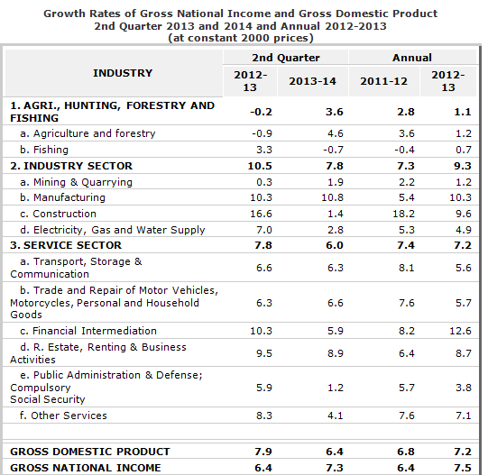
Recent Statistical Data (GDP and GNP)

Slide 12
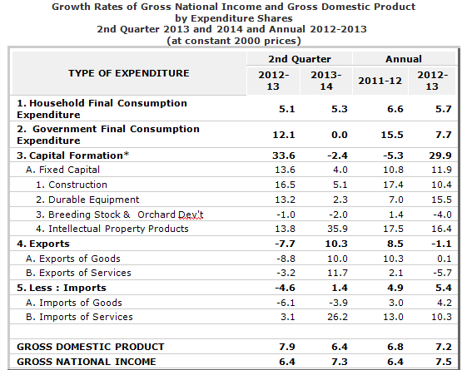
Recent Statistical Data (GDP and GNP)

Slide 13
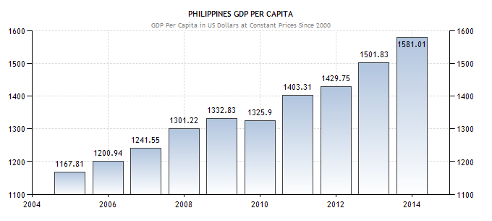
Recent Statistical Data (PCI)

Slide 14
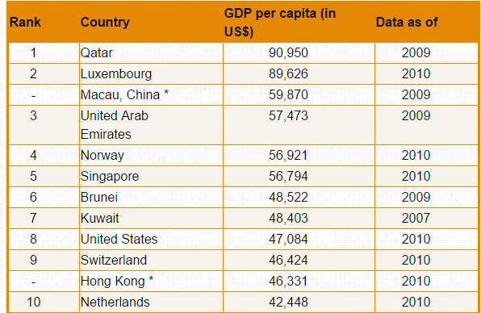
Top 10 countries in the world in terms of GNP, GDP, PCI

Slide 15
Uses of National Income Data
1. Measure of economic growth
2. Indicator of success or failure of economic
planning
3. Estimating per capita income
4. Assessing the economic performance of different
production sectors

Slide 16
Uses of National Income Data
5. Measuring inequalities in the distribution of
income
6. Measuring standard of income
7. Makes international comparison possible

Slide 17
Thank You
and
God bless!

